Slide 1

Homework
Open a new Excel sheet
Enter different set of data and get a pivot table
Sort and filter the data
Find Count of amount of each fruit
Save your project as “Homework on Pivot table”.

Slide 2
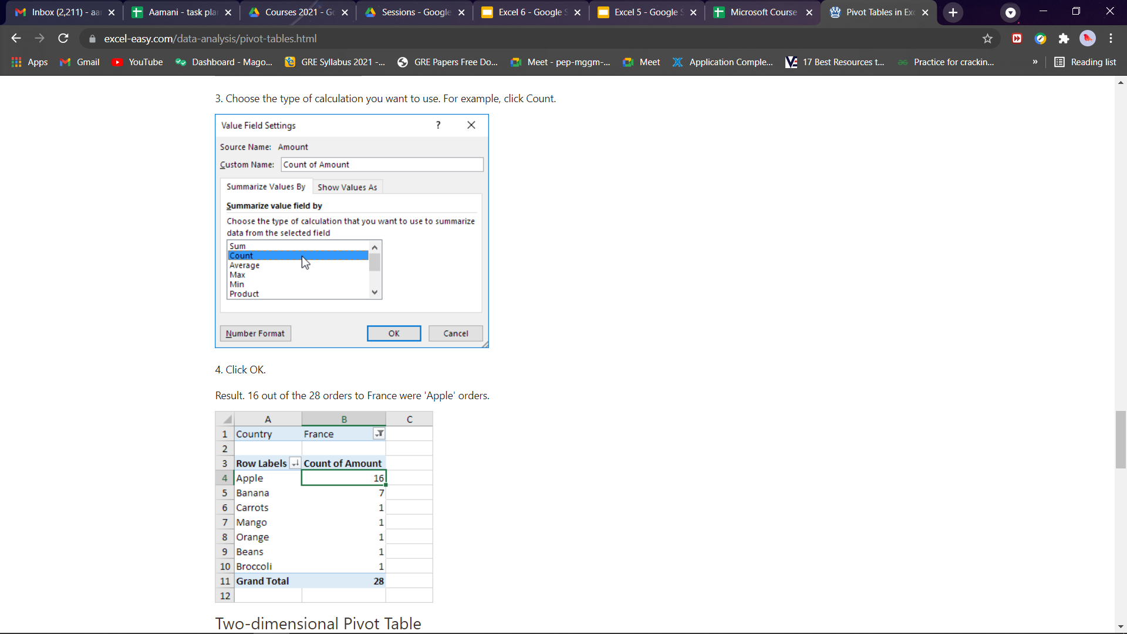
Homework Solution

Slide 3






Excel
Session - 5

Slide 4


Perform Calculations
Learn about Autosum in Home tab
Entering Formulas
Using the Sum, avg, Min and Max formulas
Editing and Sorting Fill

Slide 5
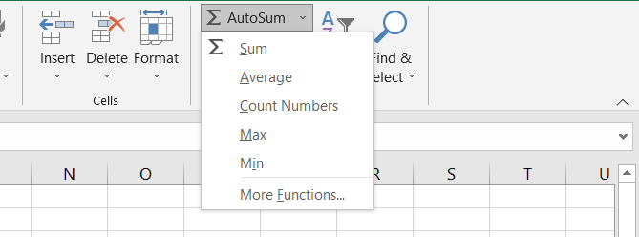
Performing Calculations

Slide 6
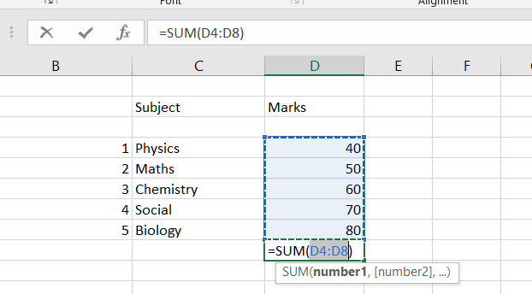
Performing Calculations
Using Autosum, we can calculate sum,average, min,max of cells

Slide 7
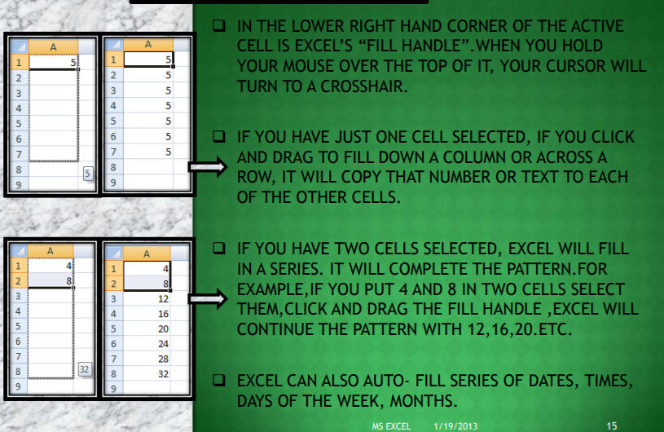

Editing fill

Slide 8
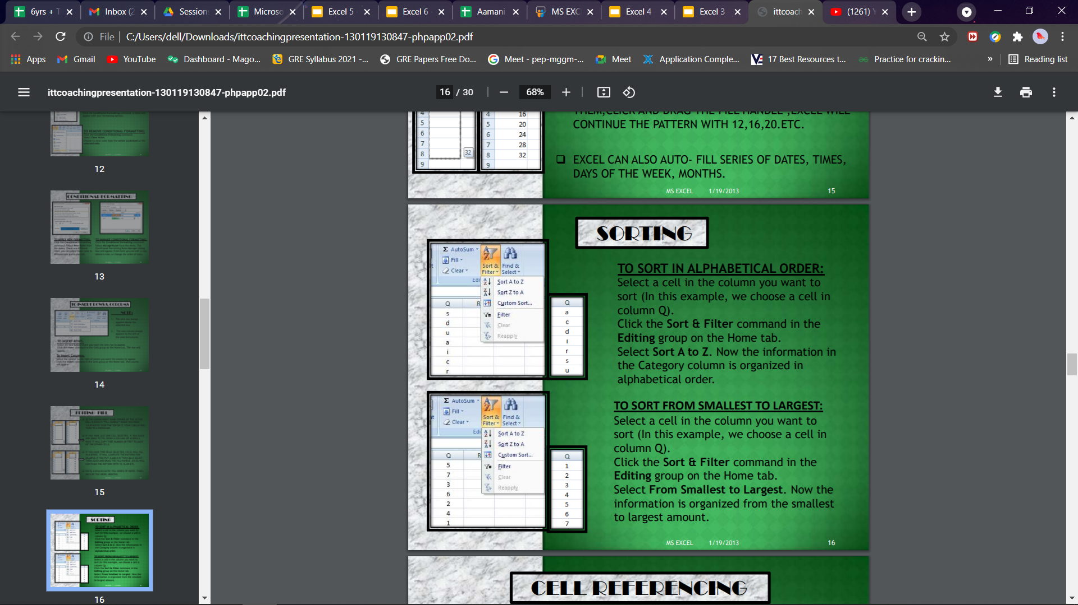
Sorting

Slide 9

Task
Open a new Excel sheet
Enter data in the cells, change font style, font size-14, text colour
Format data as a table and Apply borders
Find sum,average, min and max of the data you entered.
Save your project as “Calculations”.

Slide 10
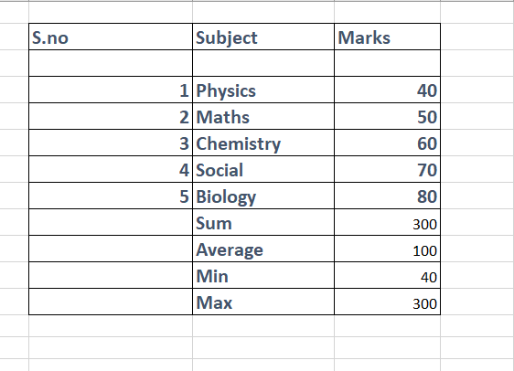
Solution

Slide 11


Homework
Open a new Excel sheet
Enter data in the cells of 5 subjects
Apply cell style and find average of subjects score
Save your project as “Homework on Calculations”.

Slide 12

ANY QUESTIONS ???

Slide 13



THANK YOU !
contact@littleinventors.in 0091-8368822963 www.littleinventors.in

